Slide 1
Harish R
721221243020
III – BTech- Artificial Intelligence and Data Science
Final Project
3/21/2024 Annual Review

Slide 2
PROJECT TITLE
Deep Noise Suppression Deep Learning-based Noise Suppression for Audio Enhancement
3/21/2024 Annual Review

Slide 3


AGENDA
Introduction to Deep Learning and Image Processing
Importance of Data Preprocessing
Common Preprocessing Techniques
Implementing Preprocessing with Libraries
Challenges and Considerations
Project Overview
Solution Proposition
Wow Factor in Solution
Conclusion
3/21/2024 Annual Review

Slide 4

PROBLEM STATEMENT
Significant Advancements in Audio Signal Processing: Over the years, there have been notable advancements in audio signal processing techniques aimed at enhancing audio quality and reducing unwanted noise.
Persistent Challenge of Noise Suppression: Despite these advancements, effective noise suppression remains a challenging task. Various factors contribute to the complexity of this problem, including the diverse nature of noise sources and the dynamic environments in which audio signals are captured.
Real-World Scenarios: In real-world scenarios, audio signals are often contaminated by different types of noise, such as background chatter, environmental sounds, electrical interference, and microphone artifacts. This makes it difficult to isolate the desired signal from the surrounding noise.
3/21/2024 Annual Review

Slide 5

PROJECT OVERVIEW
Briefly introduce the project aimed at developing a deep learning model for a specific task
Mention the dataset used for training and evaluation.
Highlight the importance of preprocessing in the context of the project.
3/21/2024 Annual Review

Slide 6

WHO ARE THE END USERS?
I prioritize accuracy and reliability in deep learning model predictions.
Interpretability of results is essential for understanding model decisions.
Efficiency and scalability are crucial to handle large volumes of data.
I value flexibility to adapt models to evolving needs and datasets.
Integration into existing workflows should be seamless and user-friendly.
Performance metrics and benchmarking help assess model effectiveness.
Continuous improvement through feedback is important for real-world applications.
3/21/2024 Annual Review

Slide 7
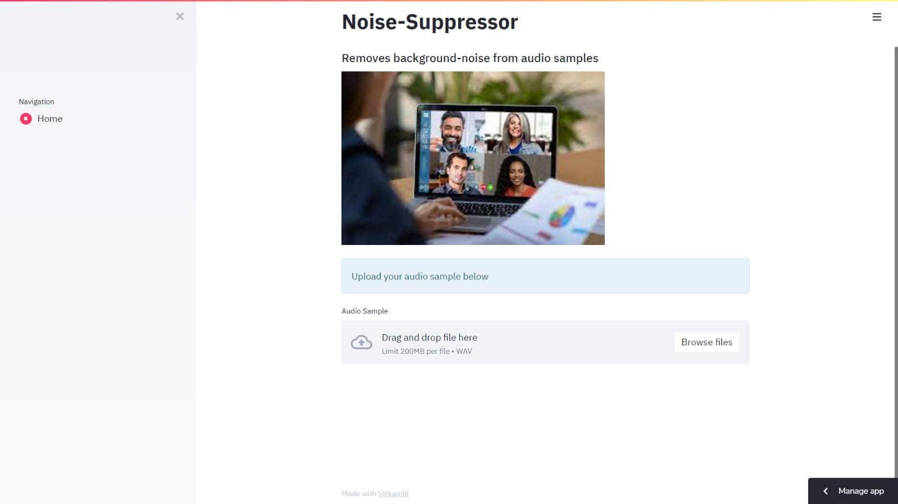
IMPLEMTATION

Slide 8
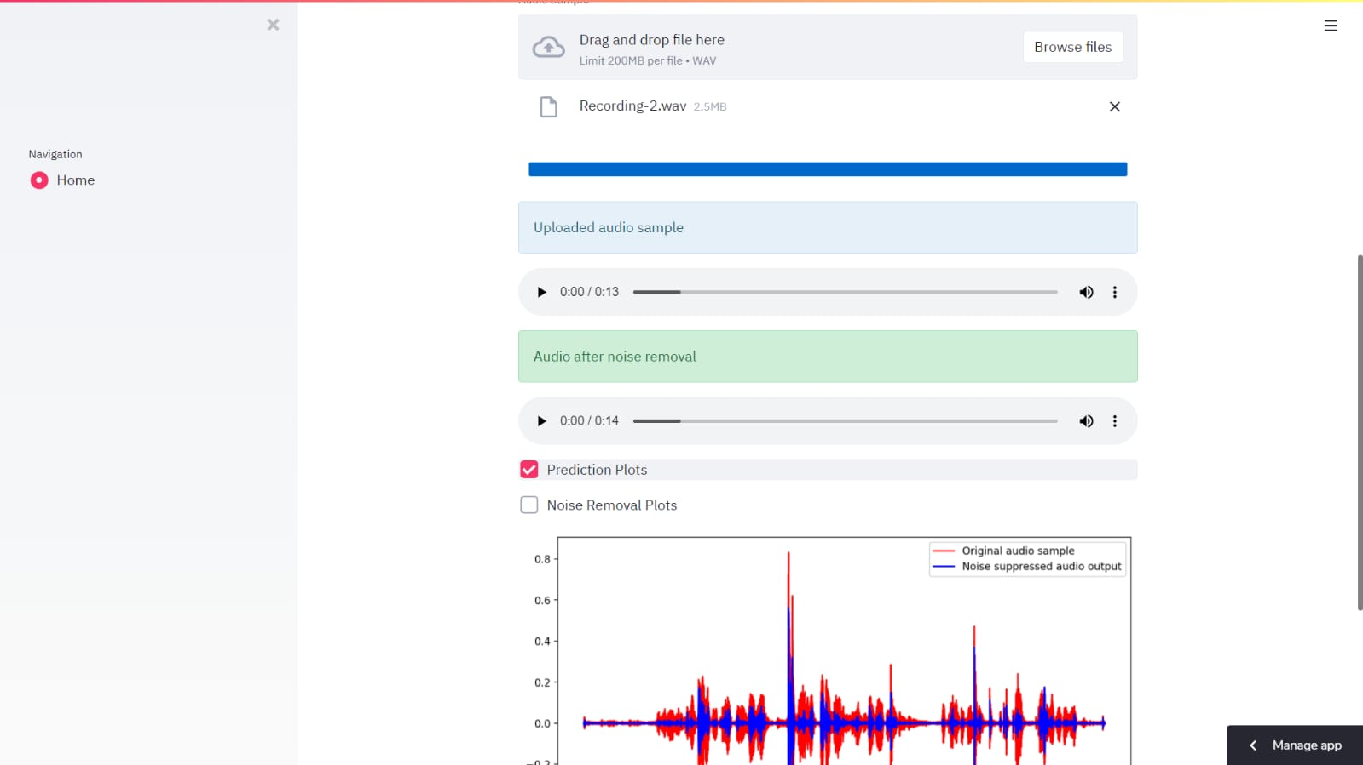
YOUR SOLUTION AND ITS VALUE PROPOSITION

Slide 9
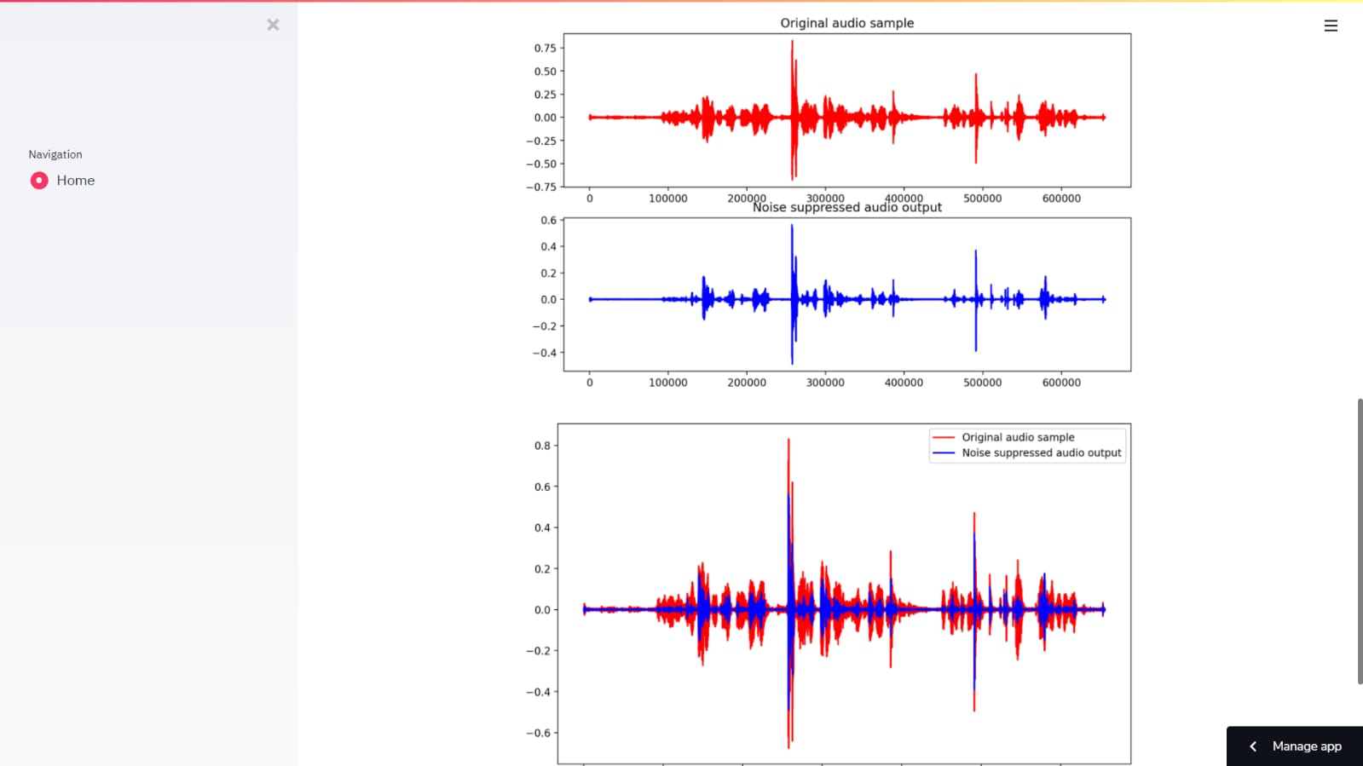
THE WOW IN YOUR SOLUTION
3/21/2024 Annual Review

Slide 10
MODELLING
Define the problem of noise suppression in audio signals with a clear focus on target applications.
Gather a diverse dataset of noisy audio samples along with their clean counterparts.
Preprocess the data by resampling, segmenting, and augmenting to enhance variability.
Select an appropriate deep learning architecture like CNNs, RNNs, or specialized models like WaveNet.
Train the chosen model using the prepared dataset, optimizing hyperparameters and loss functions.
Evaluate model performance using metrics like SNR, PESQ, or subjective listening tests.
Fine-tune the model based on evaluation results to improve performance if necessary.
Deploy the trained model in the target application environment, optimizing for inference speed and resource constraints.
Integrate the model with existing systems or frameworks as required for seamless operation.
Monitor the deployed model's performance and iterate as needed based on real-world feedback to maintain optimal functionality.
3/21/2024 Annual Review

Slide 11
RESULTS
The result of this project would ideally be a well-performing deep learning model that effectively processes image data for the specified task. Here's a summary:
Understanding Noise Suppression: Managing audio quality during virtual communication is critical today, where remote interactions have become central to our personal and professional lives. AI Noise Suppression Mechanisms: Delving into the mechanics of AI noise suppression offers a fascinating glimpse into the interplay between software and sound.
Applications Across Industries : AI noise suppression technology knows no boundaries regarding its applications across various industries. The online education space sees a notable improvement with AI noise suppression, allowing educators to teach without unwanted interruptions from their environment and providing students with a more focused learning experience
The User Experience:At the core of successful virtual communication technologies lies a seamless user experience, which heavily hinges on the quality of audio delivered.
Security and Privacy Considerations: As more personal and professional conversations migrate to digital channels, the security and privacy parameters surrounding AI noise suppression tools have garnered close scrutiny.
Demo Link :https://colab.research.google.com/github/mayureshagashe2105/Noise-Suppression/blob/main/Noise_Suppression.ipynb
D
3/21/2024 Annual Review

